Slide 1
World War I
America on the Home Front

Slide 2
Economy
Liberty bonds-special bonds sold by the government to help the allied forces
Americans bought bonds that they could later redeem for the original amount plus interest
Raised more than 20 billion dollars (paid about ¼ war cost and still loan 10 billion to allies)
Boy scouts and girl scouts set up booths to sell war bonds
Artists made colorful posters
Famous actors lead rallies to buy bonds
75,000 men gave 4 minute speeches before movies, plays and school or union meetings to sell bonds

Slide 3
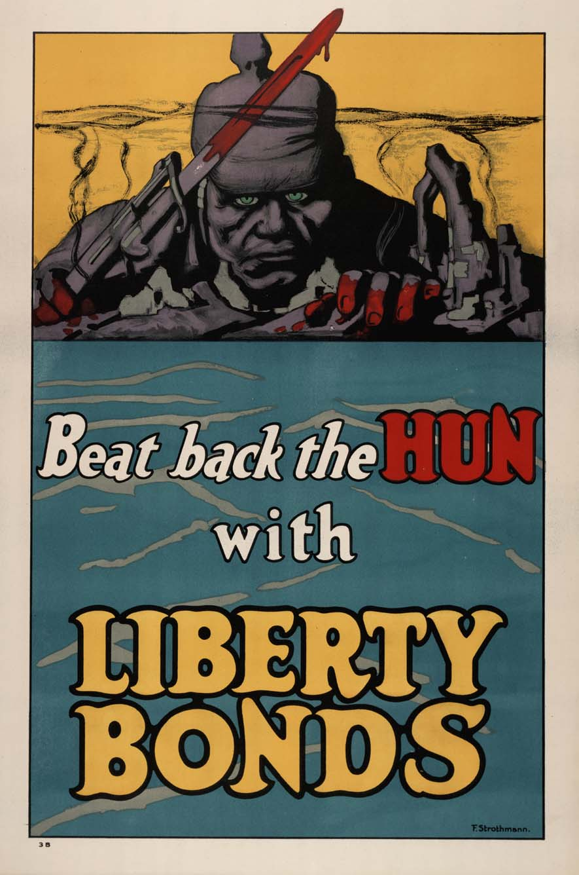
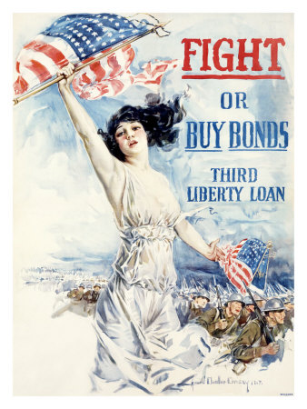
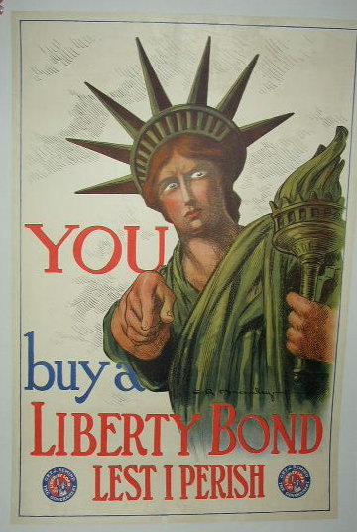
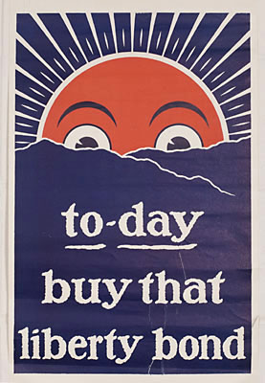
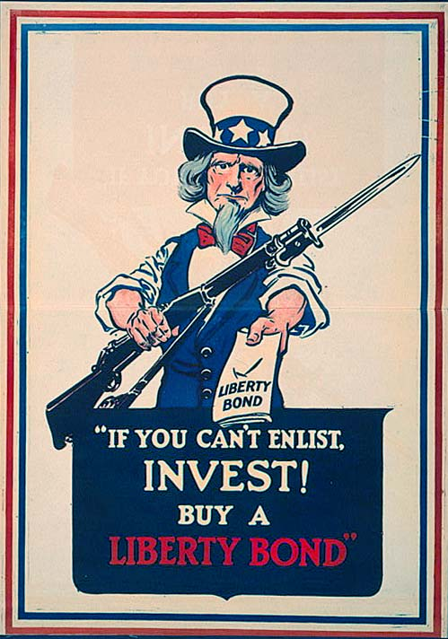
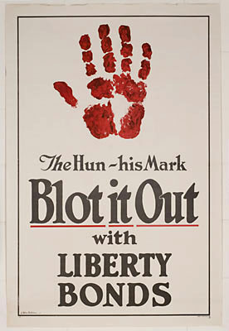

Slide 4
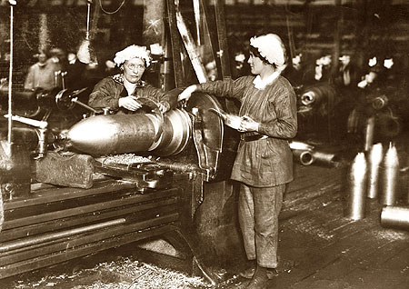
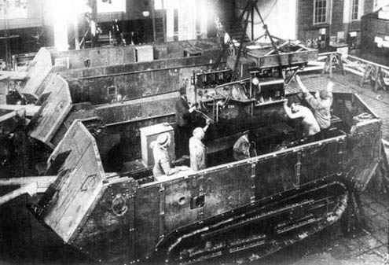
Economy
Switched from producing commercial goods to war goods
Wilson set up a bureaucracy to manage production

Slide 5
Economy
New agencies
War industries board- oversaw war related production
War trade board-licensed foreign trade
War labor board- settles any labor disputes that might disrupt war effort
War labor policies board- set standards for wages, hours, and working conditions
Labor unions won limited rights to organize and bargain collectively

Slide 6
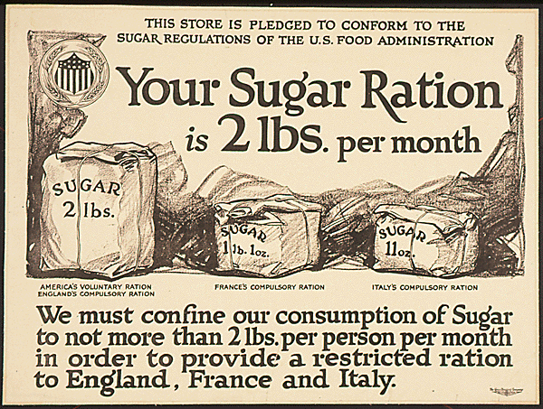
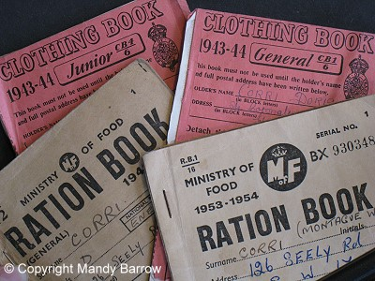
Lever Food and Fuel Control Act- gave power to manage production and distribution of food and fuels
Government managed how much food and fuel was bought by citizens
Price controls-system of pricing determined by the government
Rationing- distributing goods to customers in fixed amounts

Slide 7
Fuel administration- sponsored gasless days
Began practice of daylight savings time- clocks ahead one hour during summer to get more sunlight for farmers

Slide 8
Government Controls
News and information was under government control
Short films, pamphlets, and poster advertisement- explained war aims, and recruited
Feared that foreigners were working for other governments and would sabotage war effort
Lead to restrictions on immigration- must pass literacy test
Hatred toward Germans(Huns) emerged
High schools stopped teaching German, books by German authors were banned, composers and musicians were banned from symphony concerts

Slide 9
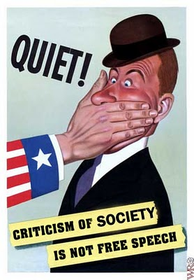
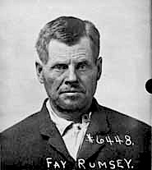
Government Controls
Espionage act- illegal to interfere with the draft
Sedition- speech or action that encourages rebellion (sedition act)
More than 1500 prosecutions and more than 1000 convictions

Slide 10
Social Changes
Flow of European immigrants nearly stopped
People worked higher paying jobs
Minorities were less discriminated against
500,000 African Americans moved to the northern cities to work in factories (Great Migration)
More women in the work force (telegraph messengers, elevator operators, letter carriers etc)

Slide 11
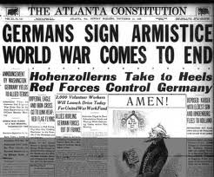
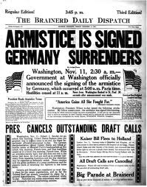
Ending the War
Central powers collapse
Bulgaria and Ottoman Empire peace with the Allies
Austria- Hungary breaks up
Poles
Hungarians
Czechs
Slovaks
German Kaiser exiled
German officials sign armistice on Nov 11, 1918

Slide 12
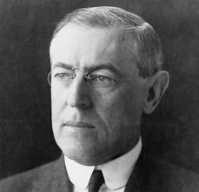
Wilson’s fourteen points
All dealt with keeping peace and preventing another world war
League of Nations
End alliances
Reduction of military
End trade barriers
Self-determination

Slide 13
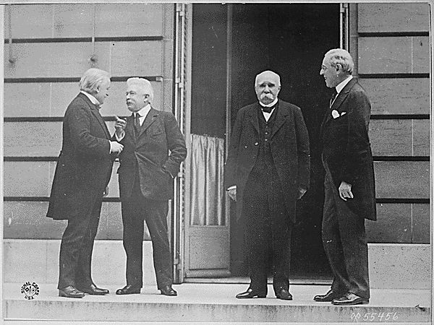
Paris Peace Conference
Wilson went for sole purpose of peace
Lloyd George (Britain), Clemenceau (France), and Orlando (Italy) wanted to make Germany pay
Land- divide German colonies
Goods
Livestock
Money

Slide 14
Paris Peace Conference
League of Nations
Ensure security and peace for all members
Members would back each other in future attacks
U.S. never signs- rejected 3 times

Slide 15
Map of Europe was redrawn
9 new nations where Austria-Hungary, Russia, and Germany were
Most were drawn with ethnic populations
But clean division was impossible

Slide 16
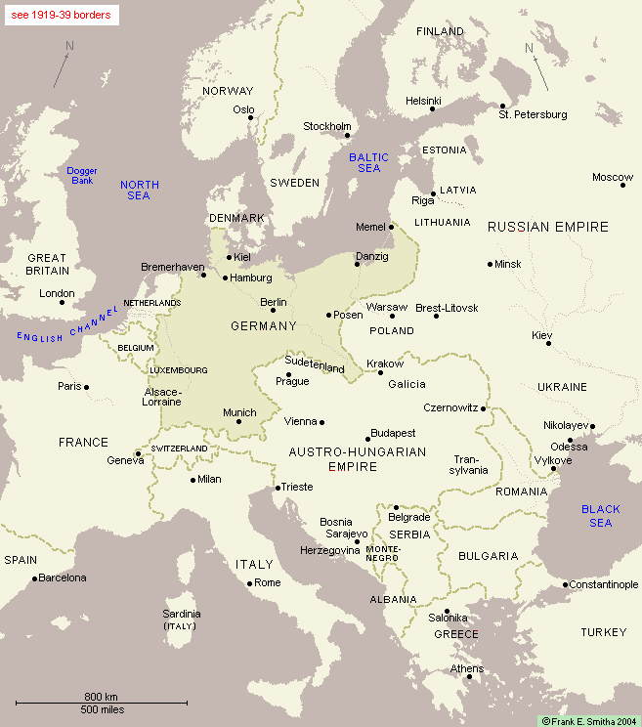

Slide 17
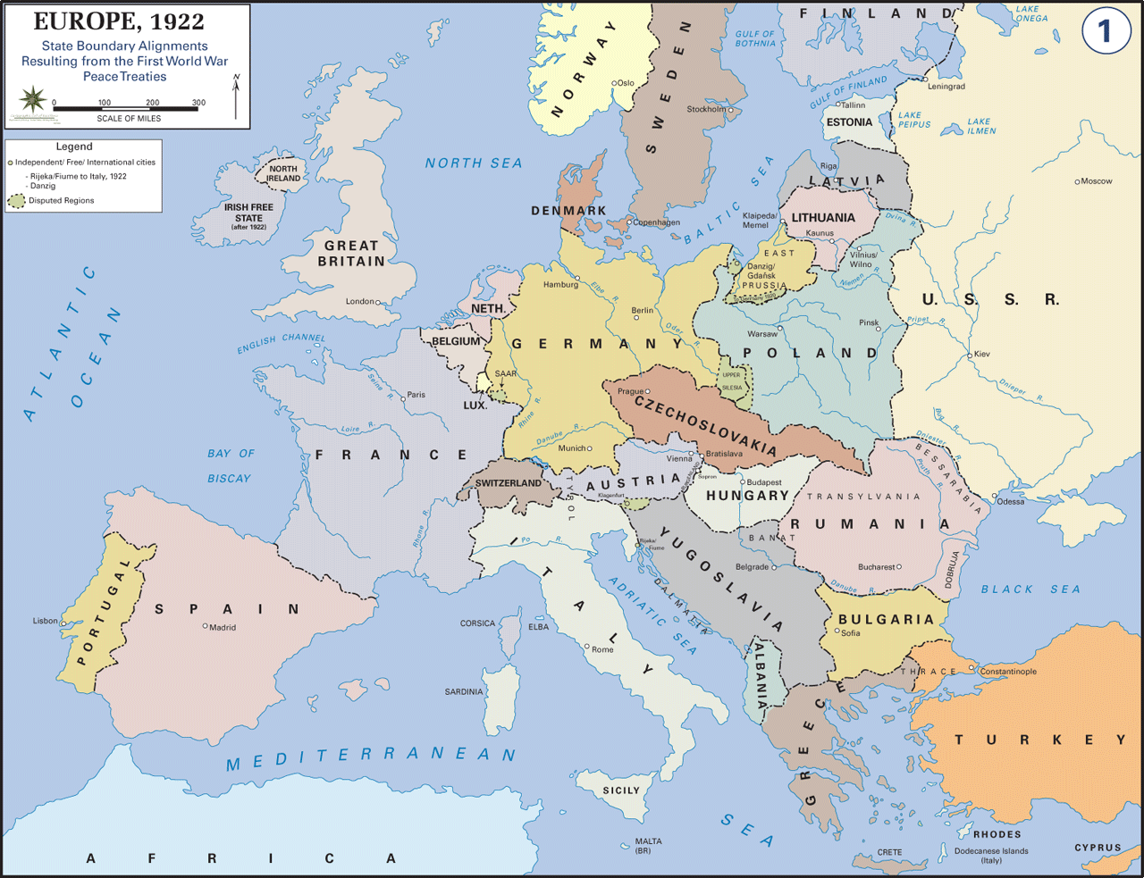

Slide 18
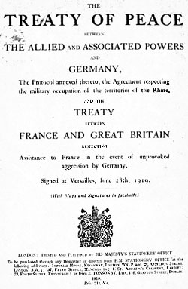
Treaty of Versailles
Signed on June 28, 1919
League of Nations was joined by most countries
Will eventually be a cause of WWII
Germany had to pay reparations
$33 billion

Slide 19
Postwar US adjustments
US was the largest creditor nation
European countries owed the US $11.5 billion
European countries power diminished due to cost of war
No plan for returning troops
Many women left jobs or lost them to give to men coming home
African American soldiers did not see the same welcoming as white American soldiers
Faced discrimination in housing and employment
Lynching and race riots continued

